Slide 1
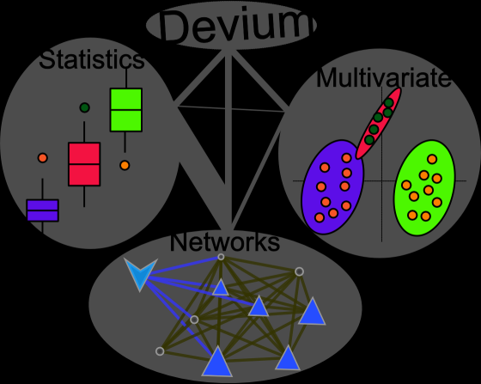
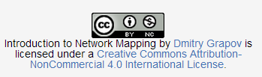
Introduction to Network mapping
Dmitry Grapov, PhD

Slide 2
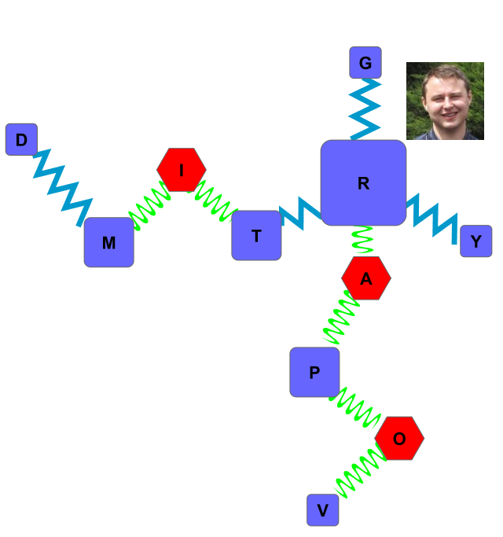
Lets Make a (your) Name Network!

Slide 3
Steps:
Make Edge list
Make Node attributes
Generate Network
Map node attributes
Final touches
Metabolomic Examples
Download demo files:
https://sourceforge.net/projects/teachingdemos/files/Network%20Mapping/Introduction%20to%20Network%20Mapping.zip/download

Slide 4

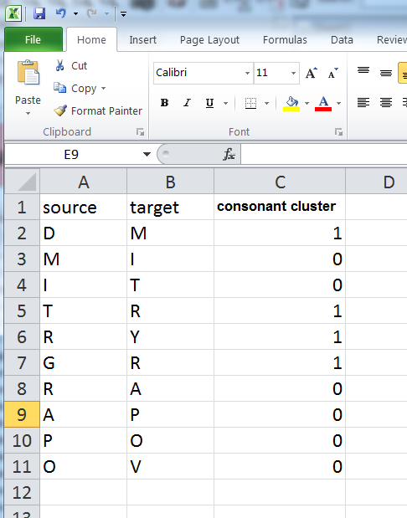
Edge List
Minimum Requirements:
2 column matrix with source (start) and target (end) nodes (e.g. letters)
extra columns can be used to set edge (connection) aesthetics (e.g. width, color, etc.)
See file “name edge list.xlsx” for an example edge list defining how the letters in my name (Dmitry Grapov) are connected with an extra column identifying consonants

Slide 5
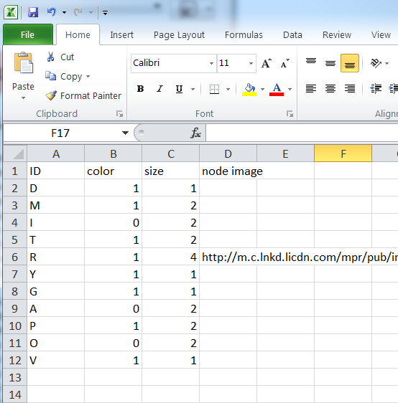
Node Attributes
Minimum Requirements:
ID for nodes (rows) must match the edge ID
Extra columns can be used to set each nodes properties (e.g. color, size, image, etc.)
See file “node attributes.xlsx” for an example node attributes file

Slide 6
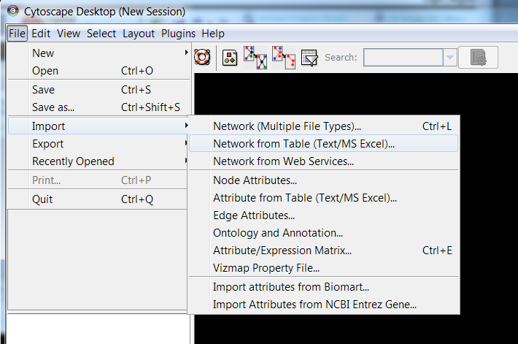
Network Generation
Get Cytoscape (its free and awesome): http://www.cytoscape.org/
(I am using v 2.83)
Step 1:
Import Edge list (this can be many forms I am using .xlsx)
1
2

Slide 7
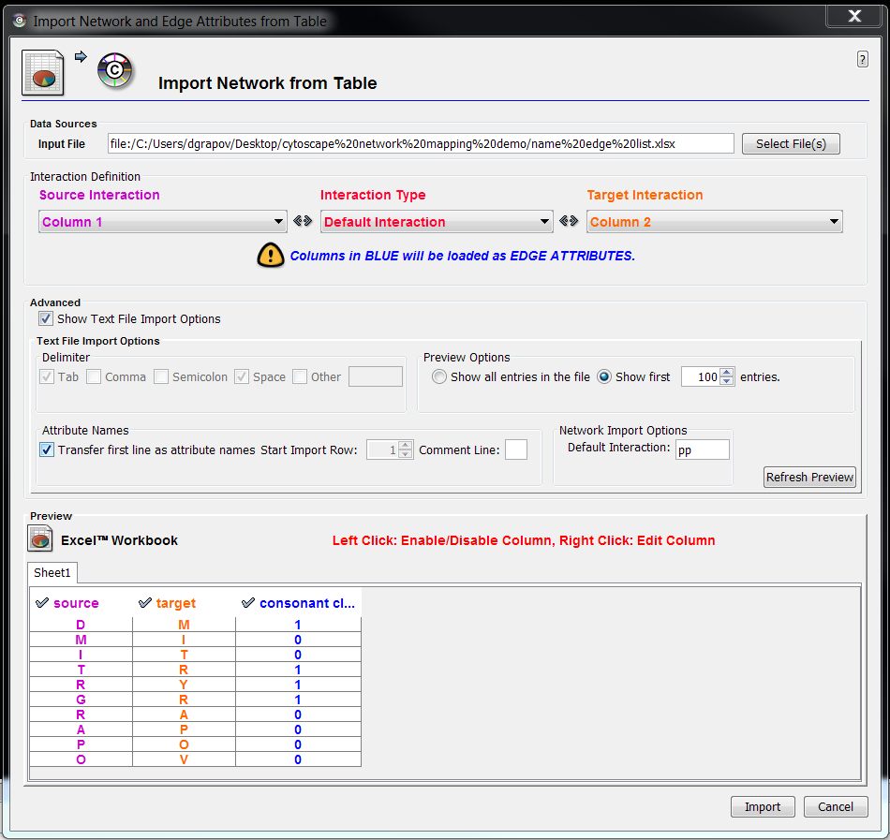
Import Edge List
1. Select file for edge list
2. Identify columns for edge (connection) source and target.
Double click column to enable edge attributes.
Hint: Show Text File Import Options>>Transfer first line…..
1
2
3
4
5
6

Slide 8
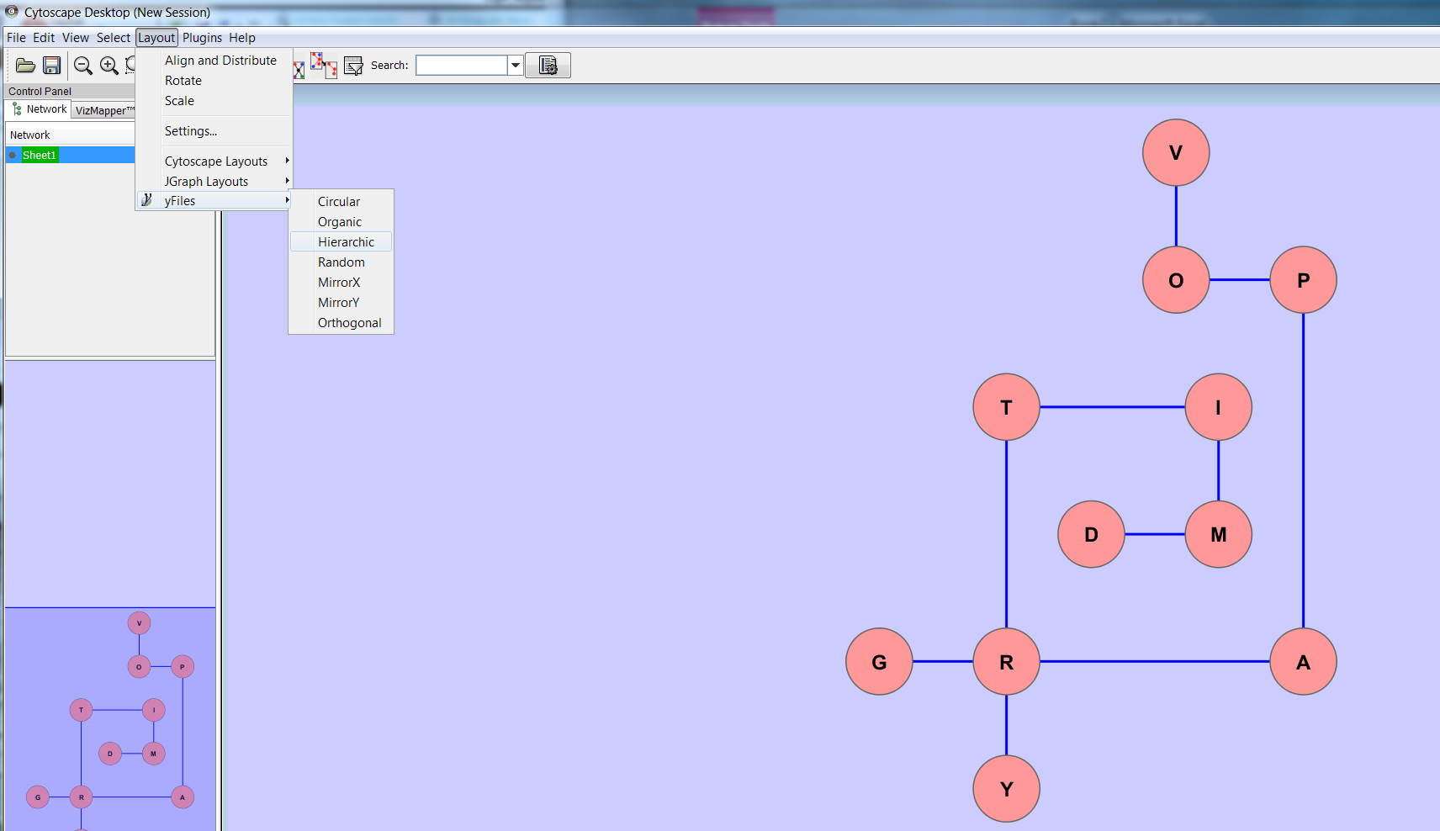
NODE Layout
Cytoscape provides many options to help auto-optimize the node (letters) layout
1
2 (3 default add-ins)
3

Slide 9
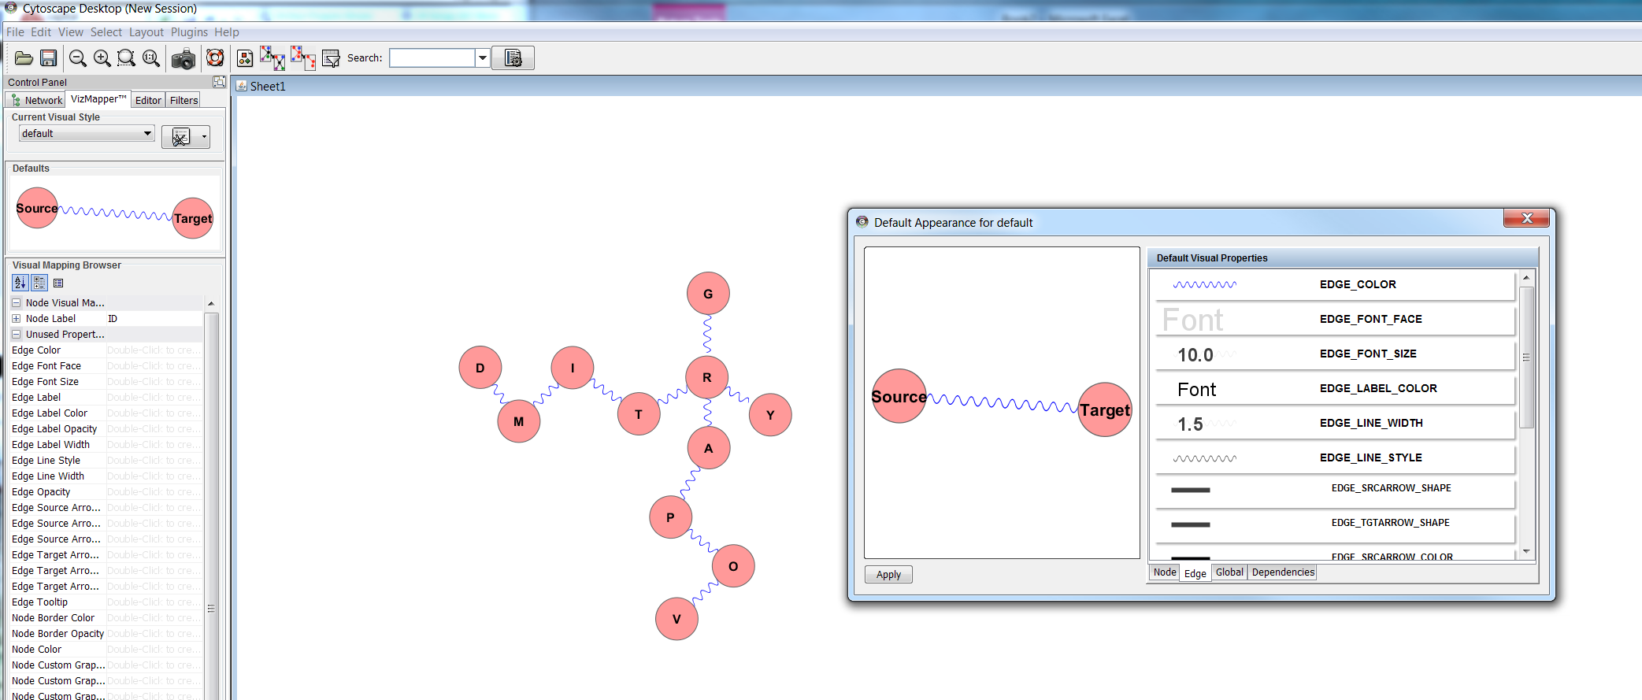
Setting Global defaults
Set defaults to modify global node, edge and other options.
Double-click on Defaults image
1
3
2

Slide 10
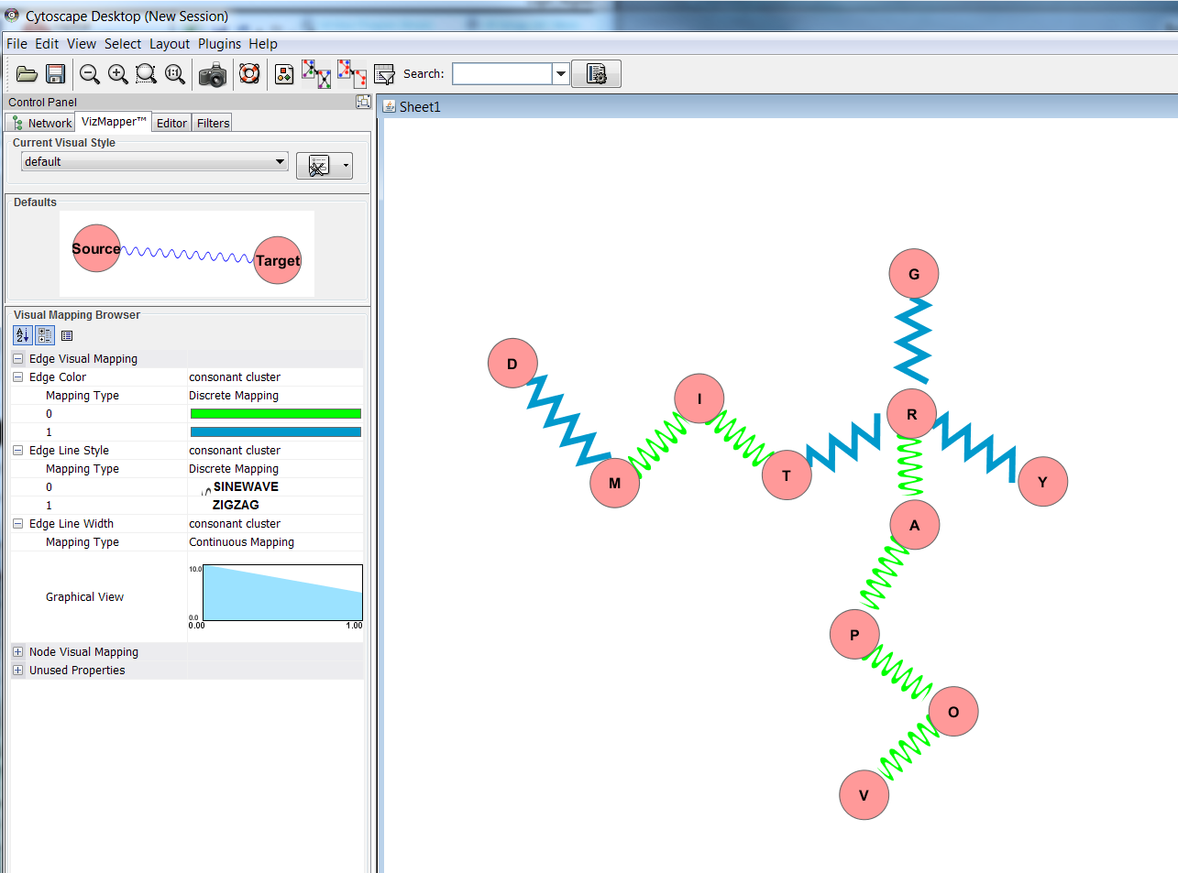
Modify Edge properties
Use the VizMapper to map “extra columns” in edge list (attributes) to aesthetics.
1

Slide 11
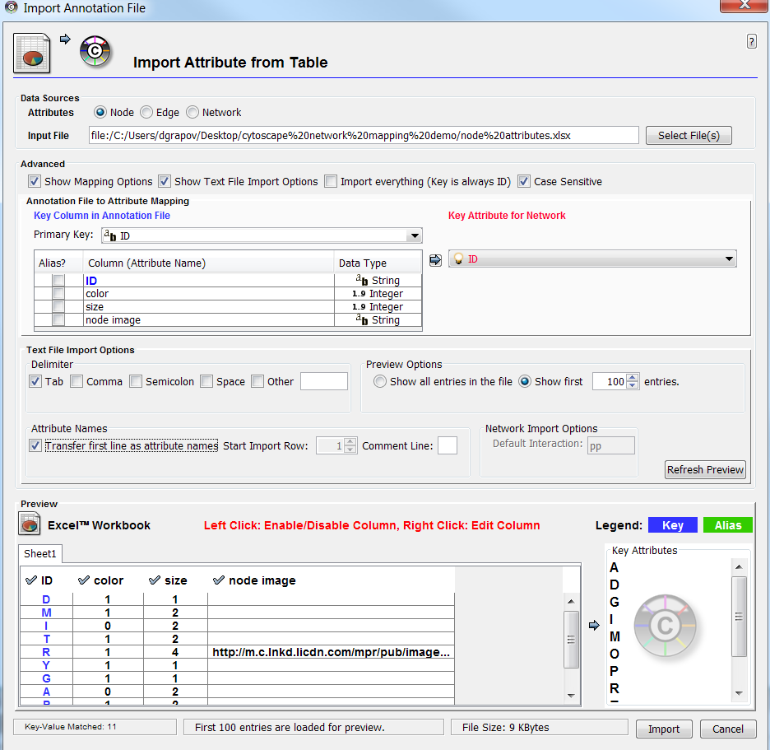
IMPORT Node Attributes
Select file for the node attributes. Extra options can be used to select node ID (must match edge list), change the file delimiter, etc.
1
3
2
4
5
6

Slide 12
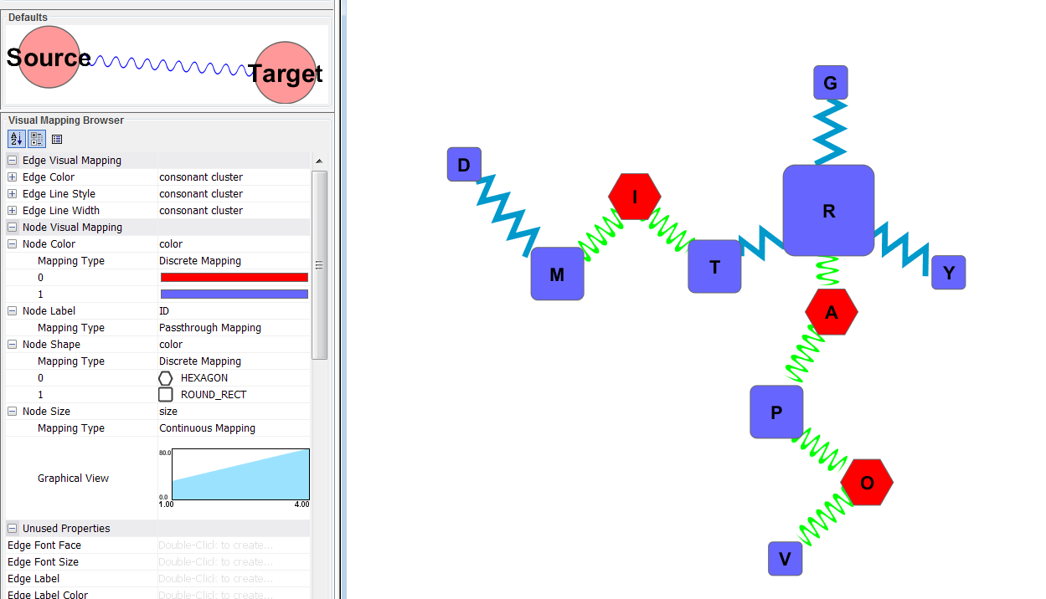
Set Node Attributes
Use the VizMapper to map node attributes.
1

Slide 13
Set Node Attributes
Use the VizMapper to map node attributes.

Slide 14
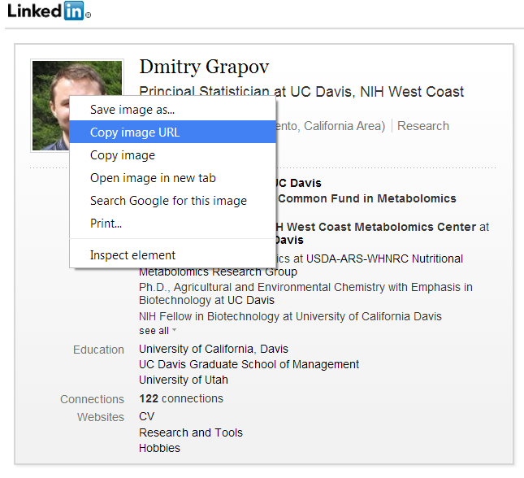
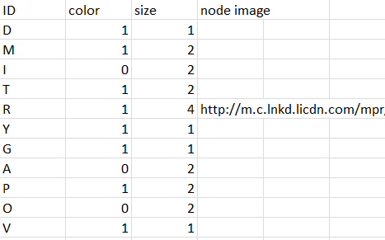
Set Node Attributes
New columns can be added to the node attributes and change the mapping in existing networks. Here I’ll add a url for a .png to use as a custom node image. Custom images can also be defined as local file path (e.g. windows: file:///C:\.....)

Slide 15
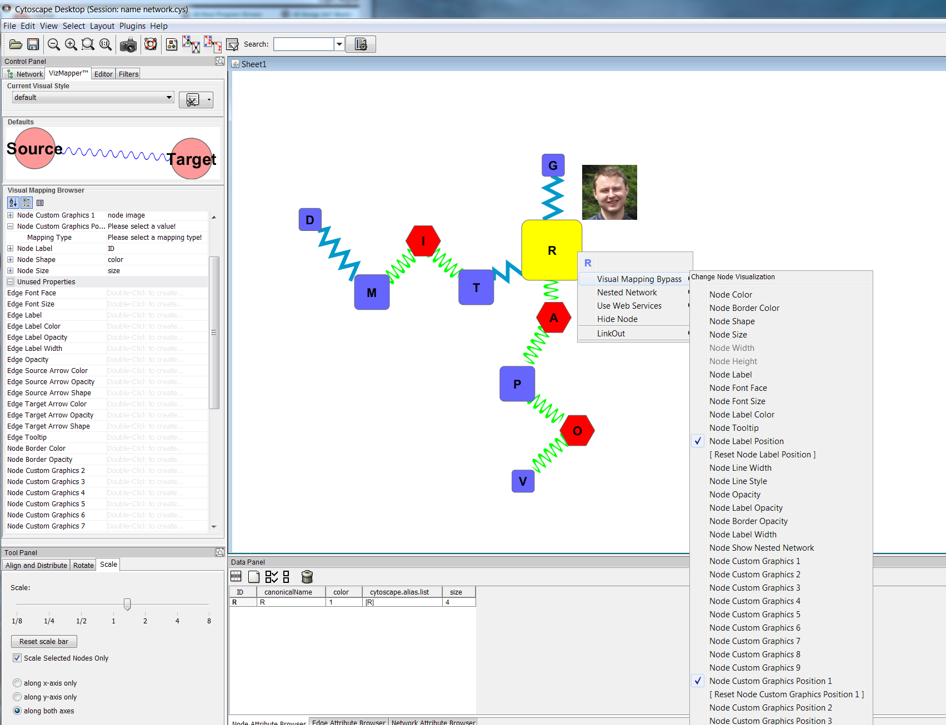
Override mapped Aesthetics
Right-click on an edge or node to manually change their aesthetics
1
2
3

Slide 16
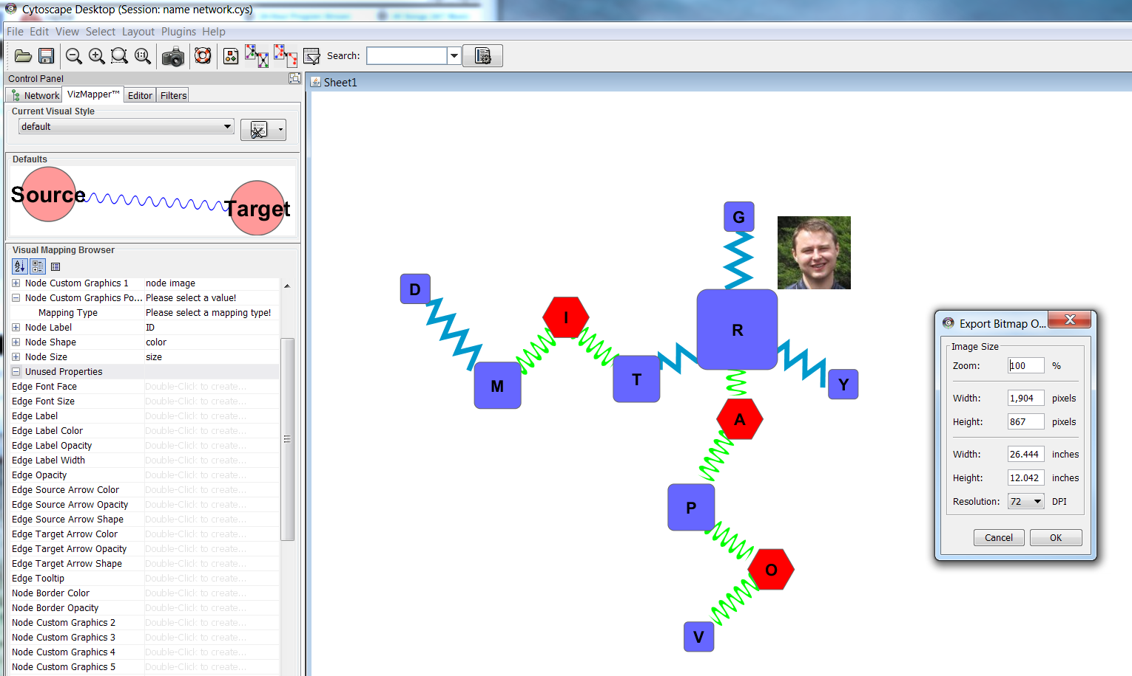
Export NEtwork
Export as .pdf or .svg to further modify (and beautify) the network.
1
2

Slide 17
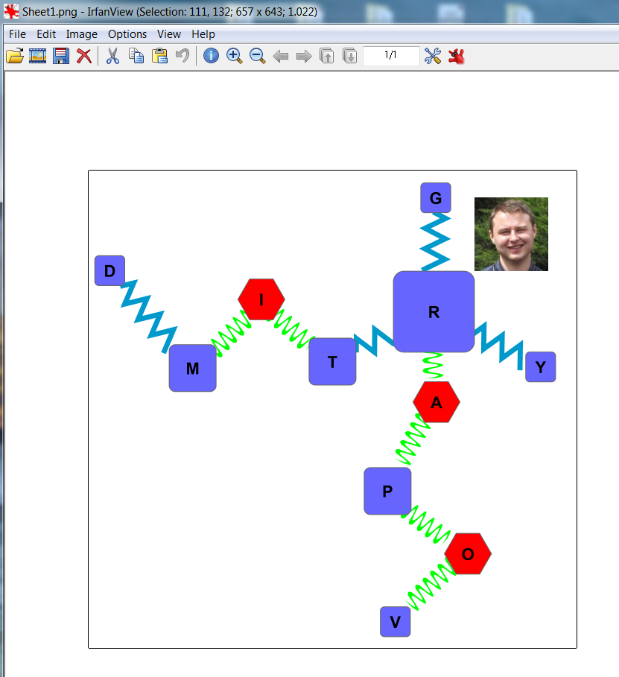
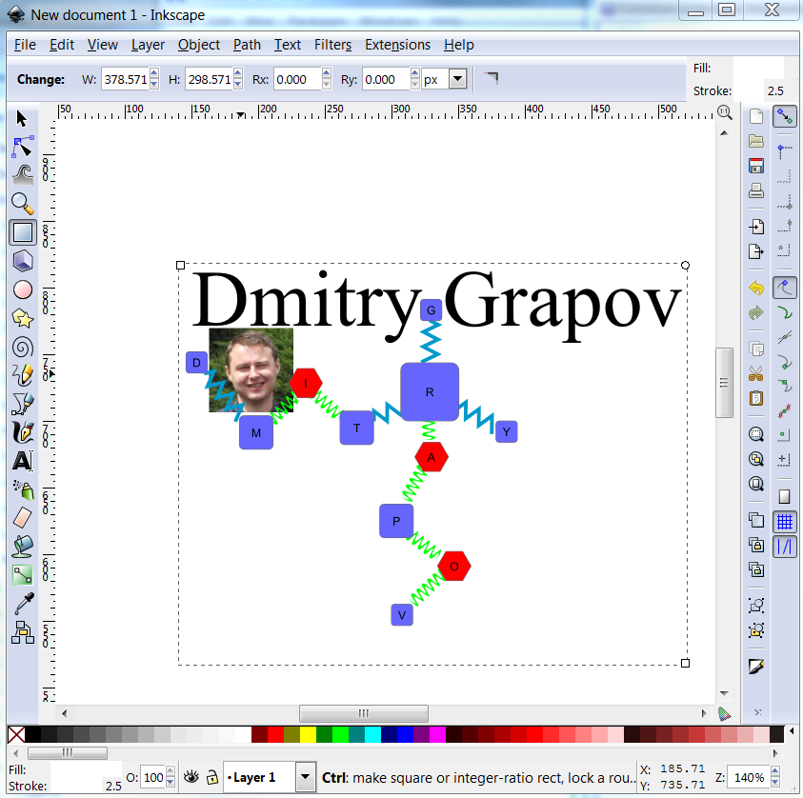
Final Touches
Use irfanview (http://www.irfanview.com/) for minor edits or inkscape (http://www.inkscape.org/en/) for complete control of final touches including making legends.

Slide 18
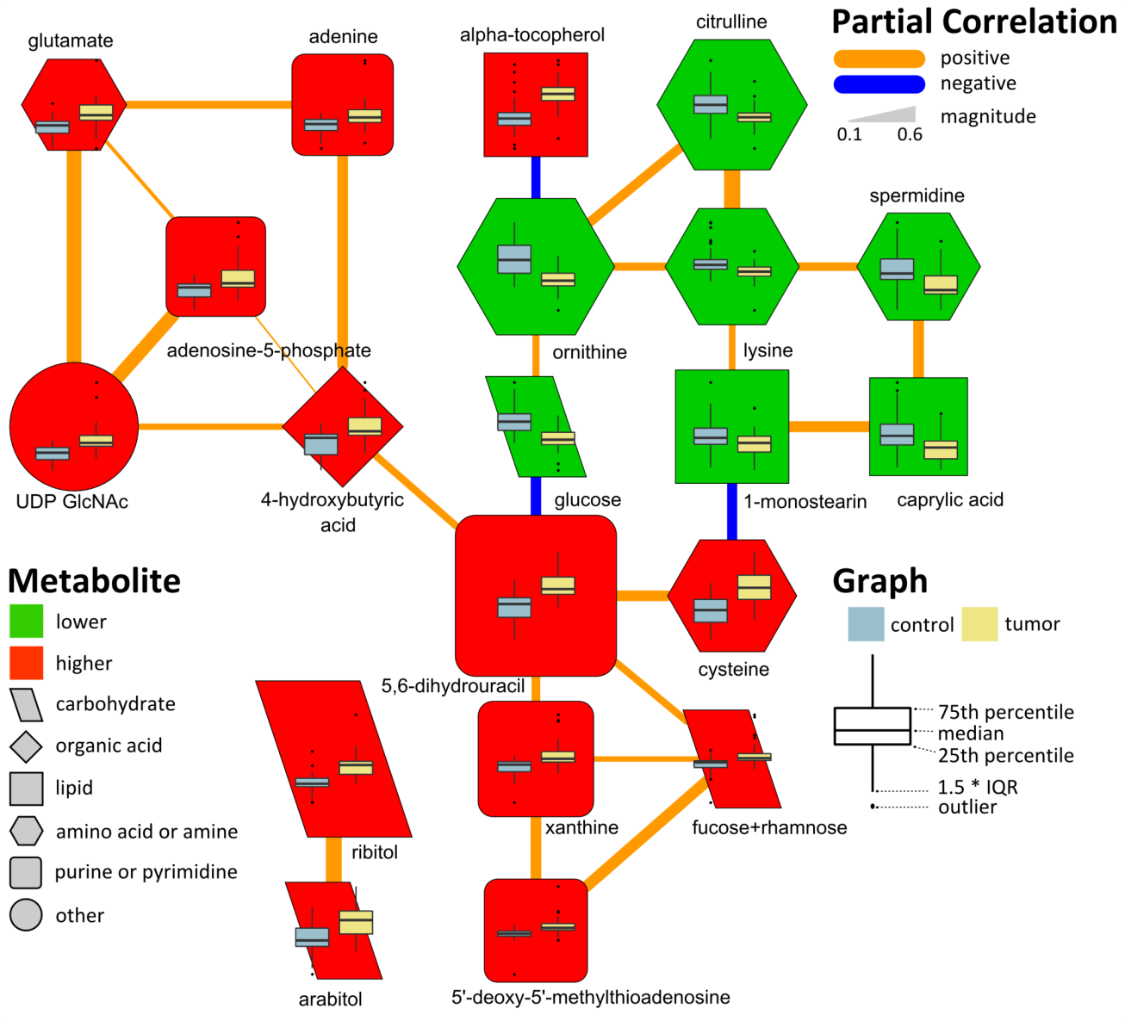
Network Examples
Partial correlation of metabolites in cancer vs. normal tissue

Slide 19
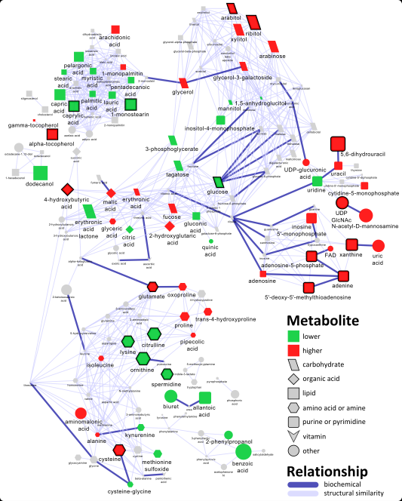
Biochemical interaction and chemical similarity network
Edge list calculated using MetaMapR:
https://github.com/dgrapov/MetaMapR
See file “biochem network edge list.xlsx”
To generate need some metabolite ID or name (e.g. KEGG ID and PubChem CID)
Node attributes calculated using DeviumWeb:
https://github.com/dgrapov/DeviumWeb
See file “biochem network node attributes.xlsx” for an overview of mapped objects and cytoscape file “biochemical network.cys” for how the mappings were assigned

Slide 20
Conclusion
Mapped networks cab be used to represent virtually any type of object or data.
These visualizations are particularly useful for high-dimensional data like metabolomics, proteomics or genomics.
Check out http://imdevsoftware.wordpress.com/category/uncategorized and https://github.com/dgrapov/TeachingDemo for more demonstrations and examples.
If you have any questions contact me at dgrapov at ucdavis.edu
Happy network mapping!

